Slide 1
Formalizing (some) Group Theory
With the goal of proving Lagrange’s Theorem

Slide 2
Table of contents
01
02
03
04
Groups
Defining groups, and then formalizing our definition in Coq
Subgroups
Defining subgroups, and then formalizing our definition in relation to Groups in Coq
Cosets
Defining an important property of cosets, and using that to define them as a whole
Proof of Lagrange’s Theorem
Mathematical proof of our theorem, outlining how to complete it in Coq

Slide 3
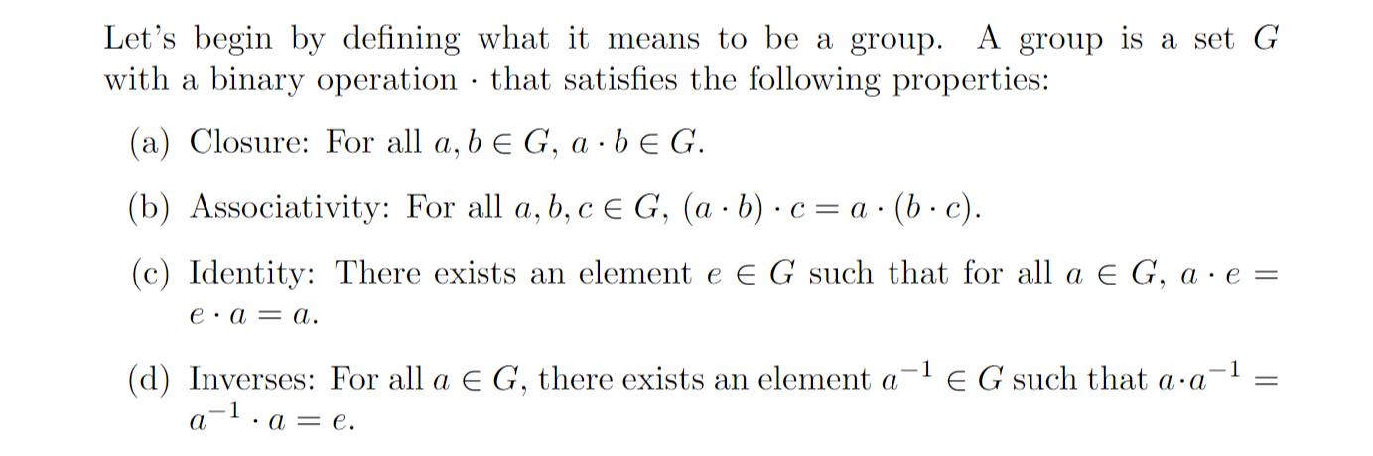
Group Definition

Slide 4
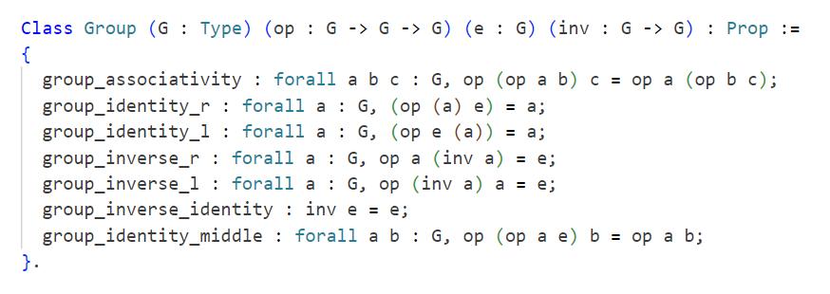
Group Definition
but formal

Slide 5
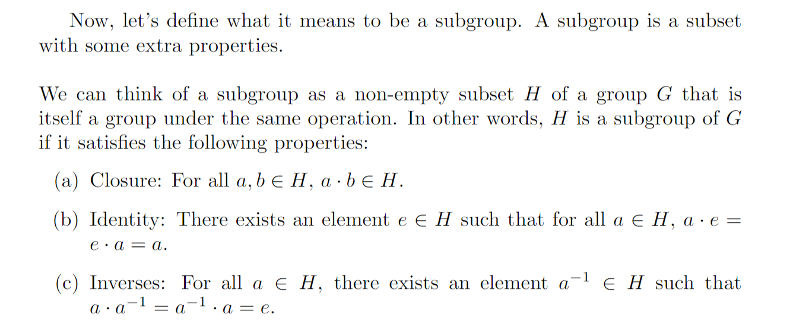
Subgroup Definition

Slide 6
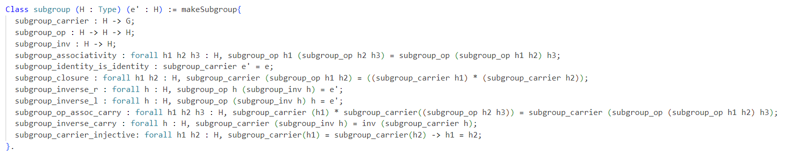
Subgroup Definition
but formal

Slide 7
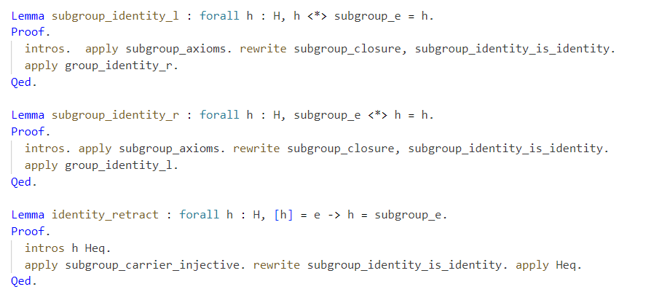
Subgroup Lemmas

Slide 8
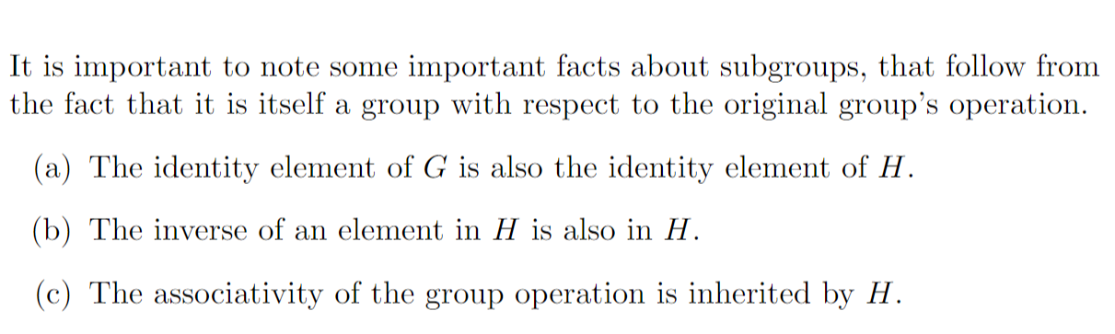

Slide 9
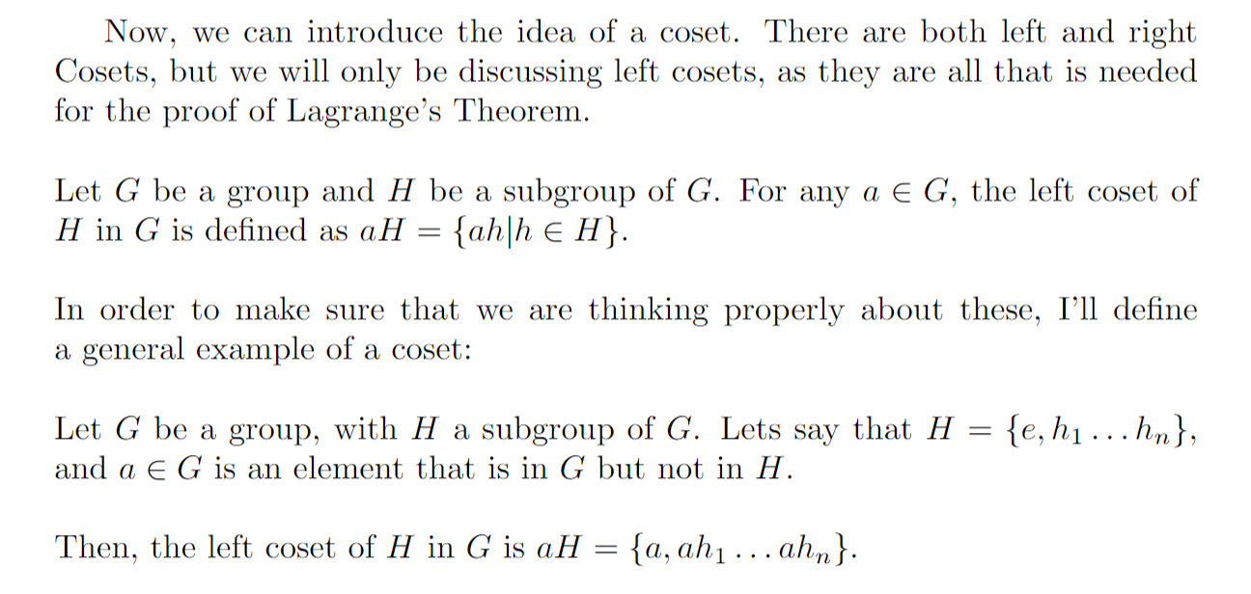
Coset Definition

Slide 10
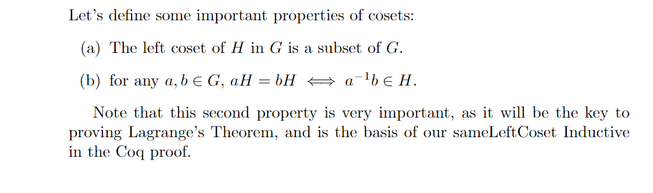
Coset Properties

Slide 11
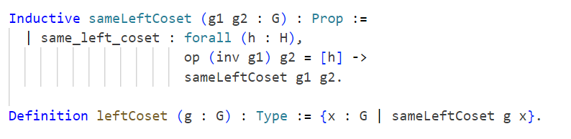
Cosets Formalized

Slide 12
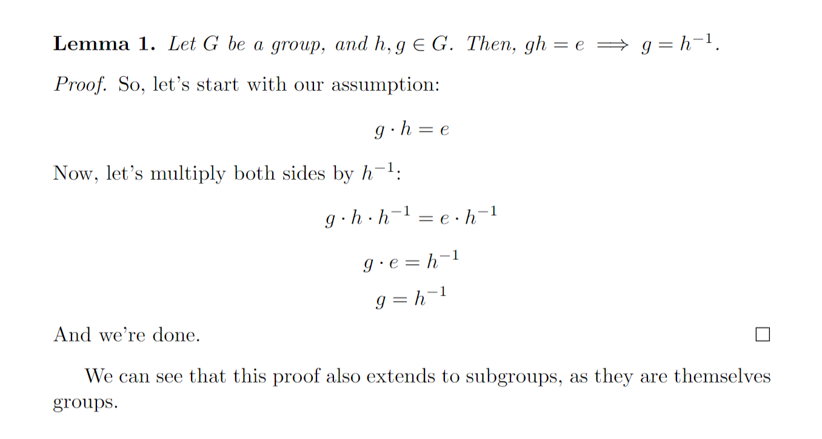
Uniqueness of Inverses

Slide 13
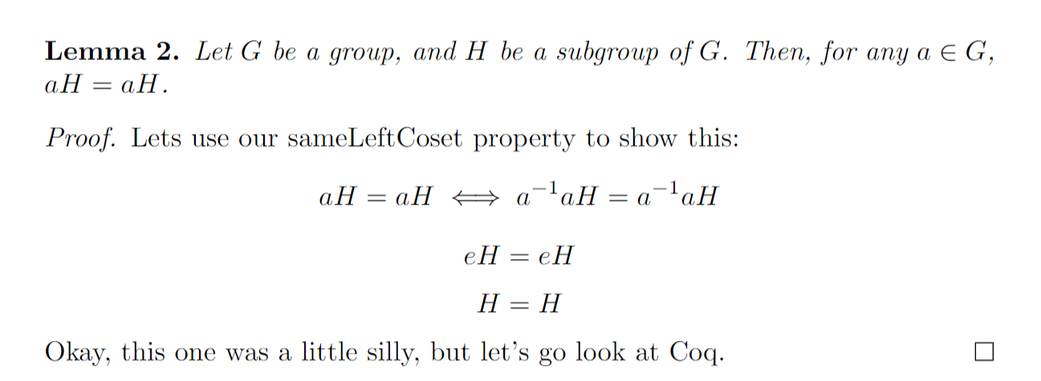
sameLeftCoset Reflexive

Slide 14
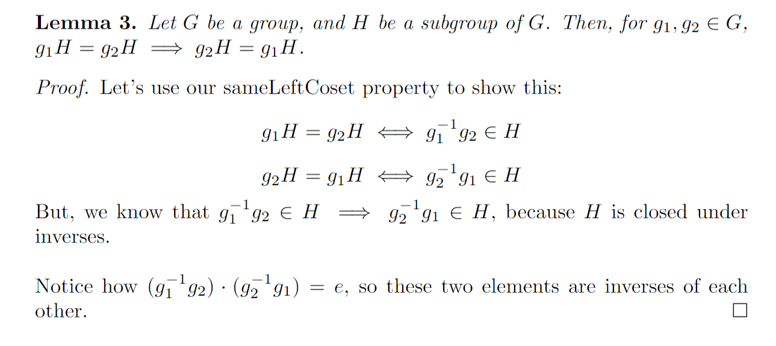
sameLeftCoset Symmetric

Slide 15
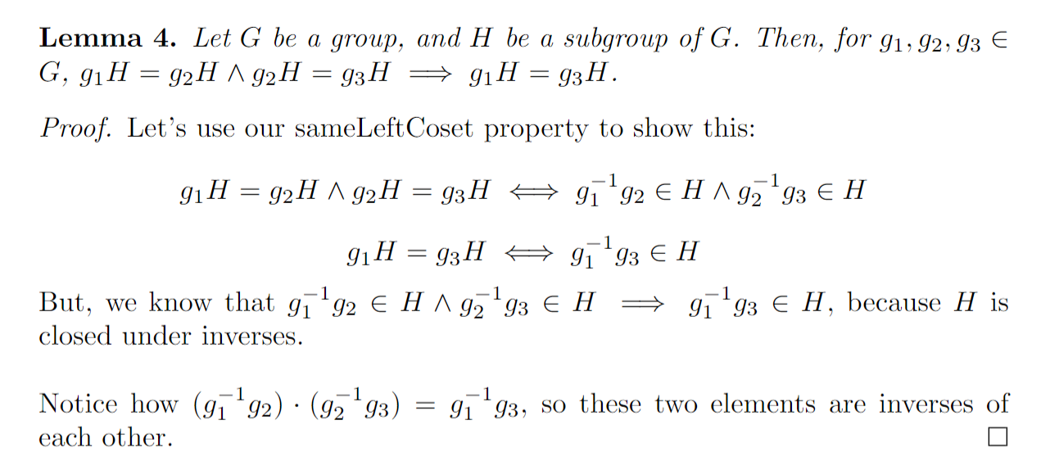
sameLeftCoset Transitive

Slide 16
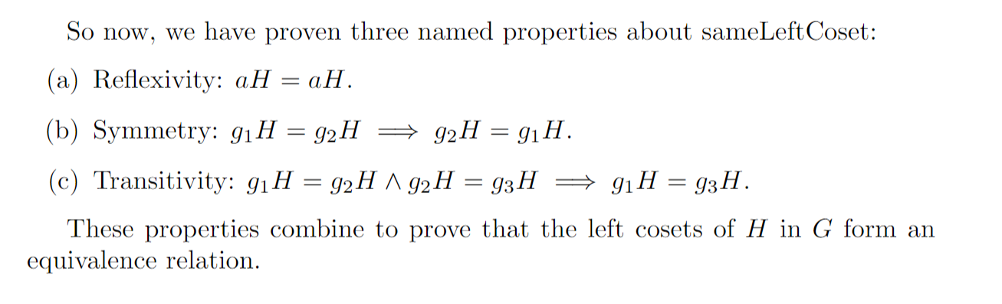
Equivalence Relation

Slide 17
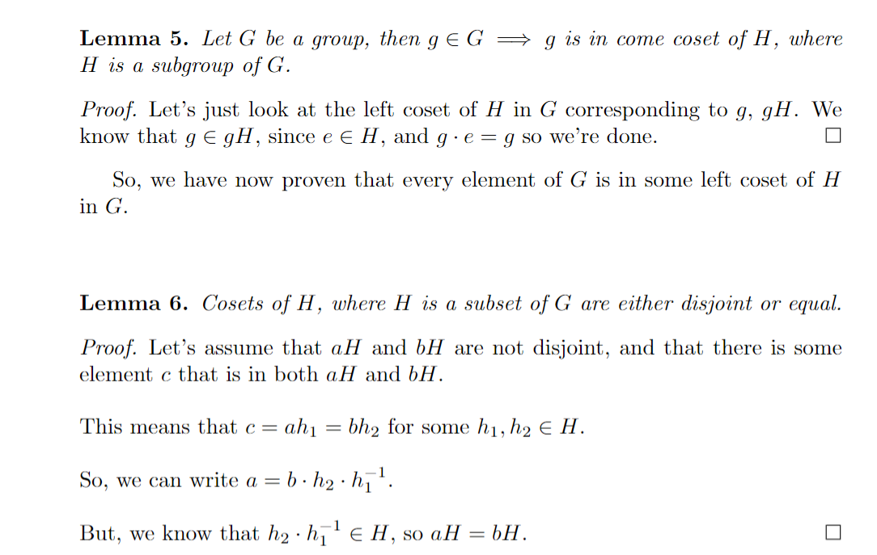
Cosets Partition G

Slide 18
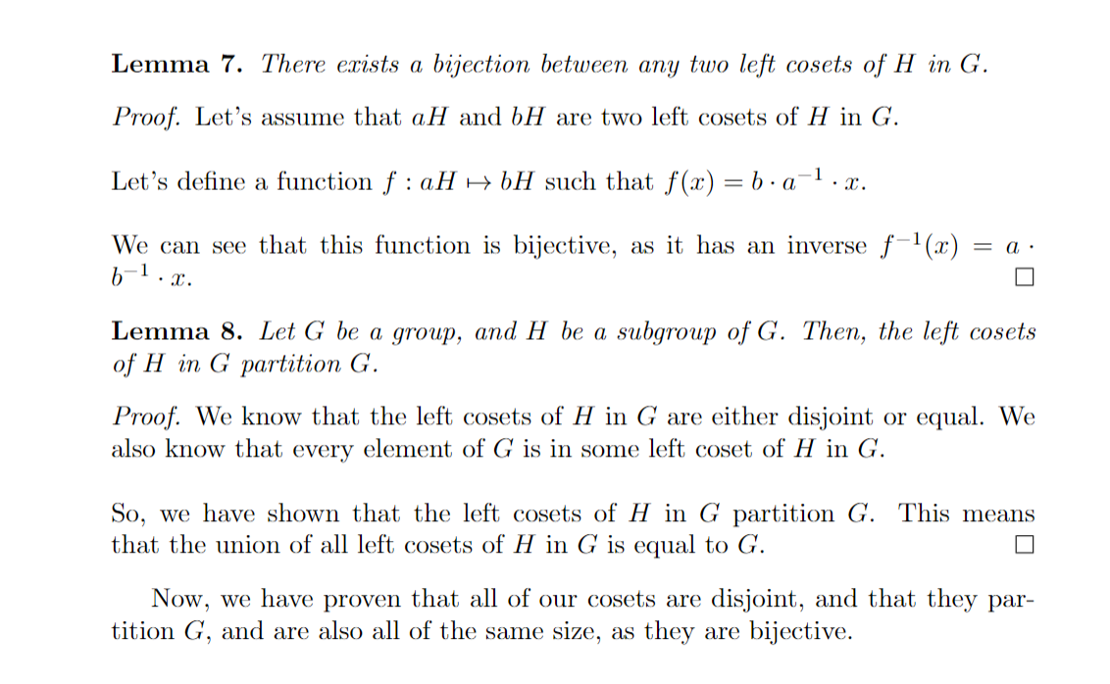
Cosets Partition G

Slide 19
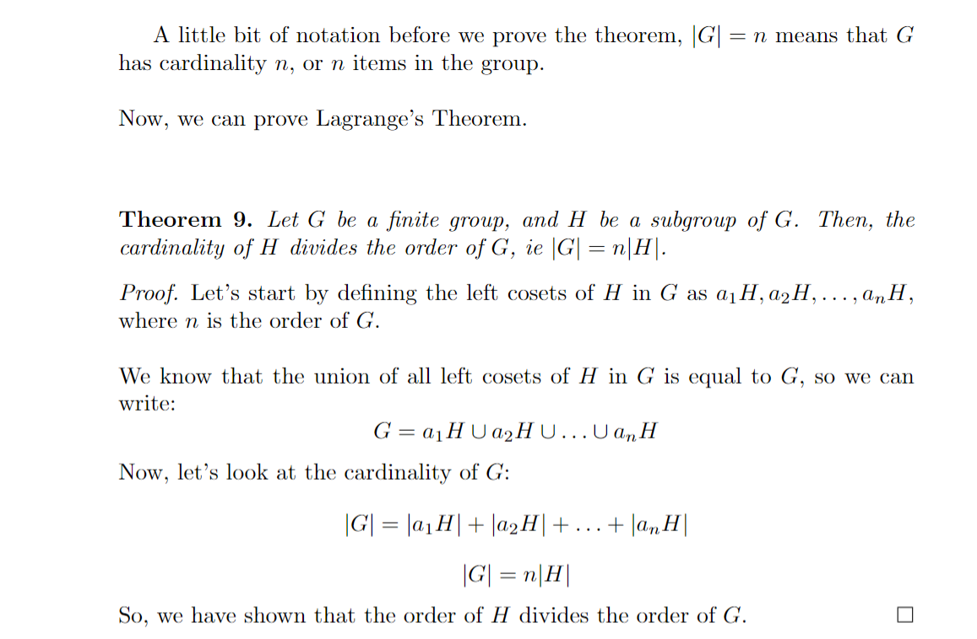
Theorem

